Slide 1
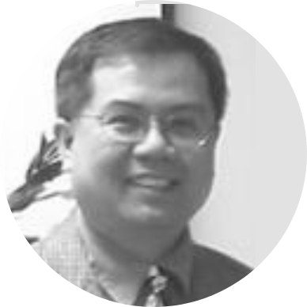
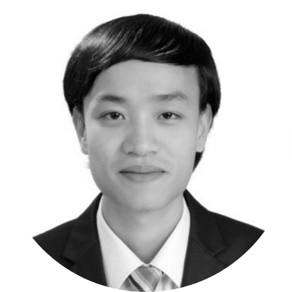
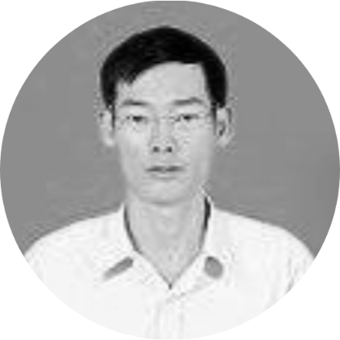
Management team
Prof. Luan Nguyen
PhD ECE, Exec MBA
CEO/President
35+ years of managerial
and technology experiences.
16 years with IBM.
1997-2000 IBM CTO
IBM Global Services.
Manage successfully
many tech companies
in US and SE Asia.
Prof. Anh Vu
PhD Aerospace Eng.
Chief Scientist
15+ years of
experiences in
aerospace design,
aerodynamics analysis,
drone and PAV design
with 10+ related projects,
30+ related publications,
patents, and awards.
Mr. Toan Nguyen
BS Info Technology Eng.
Chief Technology Officer
20+ years of
experiences in
architecting and
deploying globally
commercial enterprise
applications using
many advanced
technologies.

Slide 2
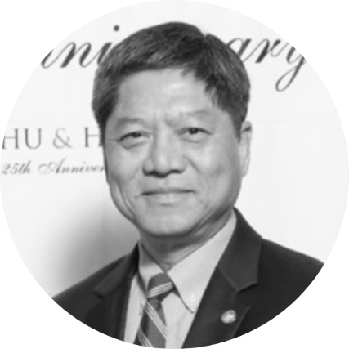
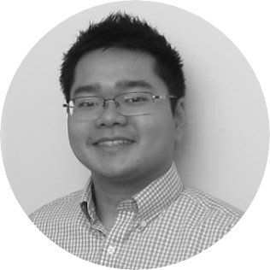
Management team
Mr. Liem Doan
BS Electrical Eng.
Chief Marketing Officer
30+ years of aerospace
C-level sales and marketing
experiences in related
commercial, military,
and defense products
in N. America, Europe,
Middle East, Asia,
and the Pacific Rim.
Mr. Trai Dang
MBA
VP of Business Development
An all-round business executive with 6 years of hand-on
management experiences, excellent program planning skills,
and established large networked connections in the digital
economy. Exceptional in running business programs with
strong business development ability in grants writings,
securing sponsorships, and in organizing
other activities that can bring additional stream
of revenues to business partnerships.

Slide 3
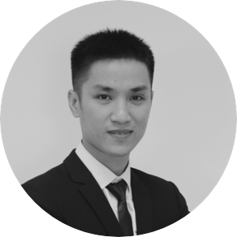
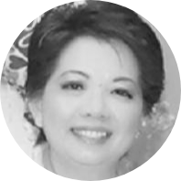
Management team
Mr. Viet Tran
BS E&T Eng.
Branch Manager, Danang Office
5+ years of experiences in researching and deploying
Embedded systems (IoT, ML, Computer Vision).
Experiences in developing high-speed/security
applications on FPGA and developing
secured firmware for Drones and IoT systems/Devices.
Exceptional in building and motivating tech teams.
Ms. Chi Hoang
BS in Business Finance
Chief Financial Officer
20+ years of experiences in corporate finance and accounting. Managed procurement organizations with an approximate spending of $350M annually. Had taken many executive leading roles such as Corporate Finance/Management Group Manager providing financial support for a Global Finance company, or as Human Resource Finance Manager providing financial support for Corporate HR to include Flash and to commit spending, headcount and reporting, managing the accurate reporting of monthly and quarter financials and forecasts into various information systems.

